Slide 1
Testing
SoftUni Team
Technical Trainers
Software University
https://softuni.bg

Slide 2
Table of Contents
What are tests?
Unit tests vs integration tests
Pytest
Mocking
Integration tests with the existing application
2

Slide 3
Have a Question?
sli.do
#Flask

Slide 4

Tests - Definition

Slide 5
Definition
Method to check whether the actual software product matches expected requirements
Ensures that software product is defect free
The purpose of software testing is to identify errors, gaps or missing requirements in contrast to actual requirements
Testing is important because software bugs could be expensive or even dangerous

Slide 6
Benefits
Cost-Effective - if the bugs caught in the earlier stage of software testing, it costs less to fix
Security - People are looking for trusted products. It helps in removing risks and problems earlier.
Product quality - Testing ensures a quality product is delivered to customers
Customer Satisfaction - UI/UX Testing ensures the best user experience

Slide 7

Unit tests vs Integration tests

Slide 8
Unit testing
In unit testing each module of the software is tested separately.
Unit testing is performed first of all testing processes
It tests parts of the project without waiting for others to be completed
Unit testing is less costly

Slide 9
Integration testing
In integration testing all modules of the the software are tested combined
Integration testing is performed after unit testing and before system testing
It tests only after the completion of all parts
Integration testing is more costly

Slide 10
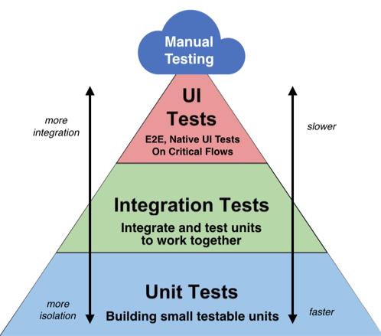
Testing pyramid

Slide 11

Pytest

Slide 12
Pytest
The pytest framework makes it easy to write small tests, yet scales to support complex functional testing for applications and libraries.
pip install pytest
# content of test_sample.py
def inc(x):
return x + 1
def test_answer():
assert inc(3) == 5
pytest

Slide 13
Grouping multiple tests in classes
# content of test_class.py
class TestClass:
def test_one(self):
x = "this"
assert "h" in x
def test_two(self):
x = "hello"
assert hasattr(x, "check")

Slide 14
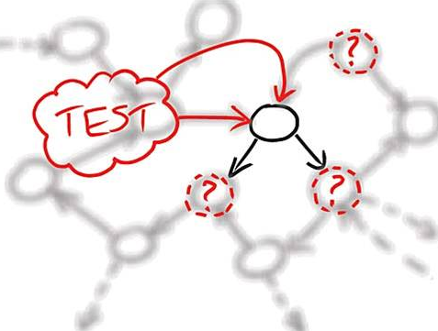
Mocking

Slide 15
Definition
Mocking is primarily used in unit testing.
An object under test may have dependencies on other (complex) objects.
To isolate the behavior of the object you want to replace the other objects by mocks that simulate the behavior of the real objects.
This is useful if the real objects are impractical to incorporate into the unit test.
Mocking is creating objects that simulate the behavior of real objects.

Slide 16
Mocking
POST
S3
DB
POST
MOCK
DB

Slide 17
Usage in python
import uuid
from unittest.mock import patch
def mock_uuid():
return "11111111"
def generate_data():
return {"name": "Test name", "id": uuid.uuid4()}
@patch("uuid.uuid4", mock_uuid)
def test_object_generation():
data = generate_data()
assert data["id"] == "11111111"

Slide 18
Result
Pytest test_sample.py

Slide 19

Adding tests to the project – live demo

Slide 20
Questions?
Notes:
20

Slide 21












SoftUni Diamond Partners

Slide 22


Educational Partners

Slide 23
Trainings @ Software University (SoftUni)
Software University – High-Quality Education, Profession and Job for Software Developers
softuni.bg, softuni.org
Software University Foundation
softuni.foundation
Software University @ Facebook
facebook.com/SoftwareUniversity
Software University Forums
forum.softuni.bg
23
Notes:
23

Slide 24

License
This course (slides, examples, demos, exercises, homework, documents, videos and other assets) is copyrighted content
Unauthorized copy, reproduction or use is illegal
© SoftUni – https://softuni.org
© Software University – https://softuni.bg
Notes:
24

